Slide 1
BIODIVERSITY CAPSTONE PROJECT - INVESTIGATING PROTECTED SPECIES
James Chapple

Slide 2
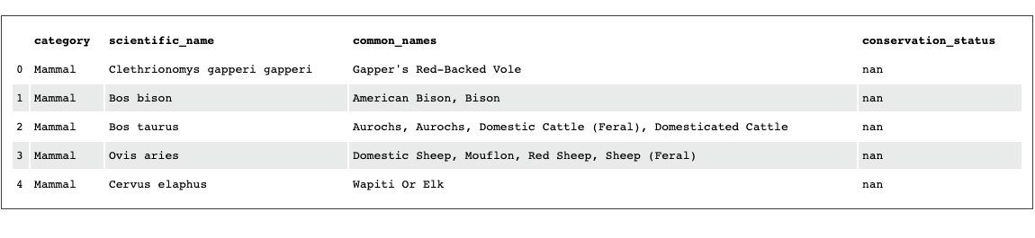
Species Info

Slide 3
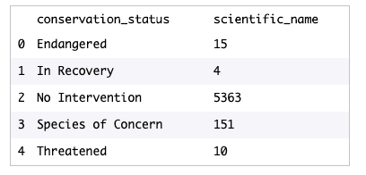
Analyze Species Conservation Status

Slide 4
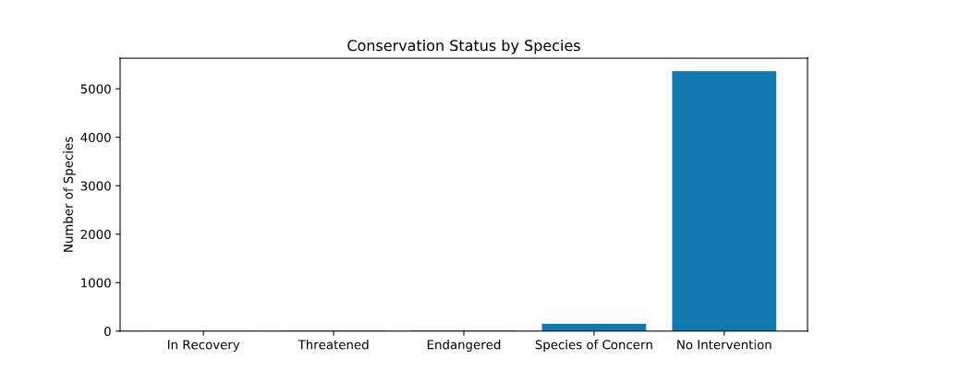
Plotting Conservation Status by Species

Slide 5
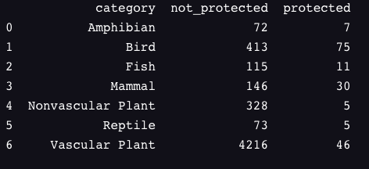
Investigating Endangered Species
Are certain types of species more likely to be endangered?

Slide 6
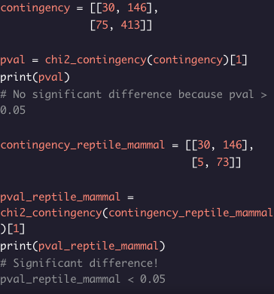
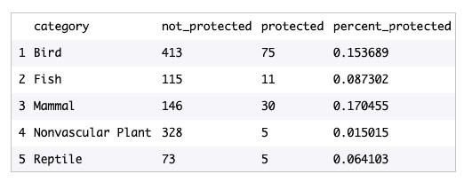
Chi-Squared Test for Significance
PVAL of Mammal & Bird not significant = 0.687594809666
PVAL of Mammal & Reptile is significant = 0.0383555902297

Slide 7
Are certain types of species more likely to be endangered? (ANSWER)
When comparing the percentages of protected reptiles and mammals using chi-square we calculated 0.038 which is significant. In conclusion there are certain types of species that are more likely to be endangered than others.

Slide 8
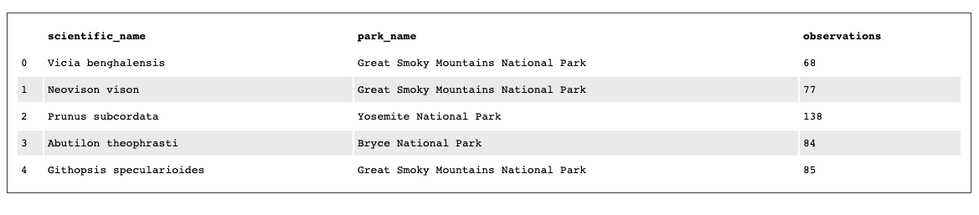
Observations From National Parks (7 Days)

Slide 9
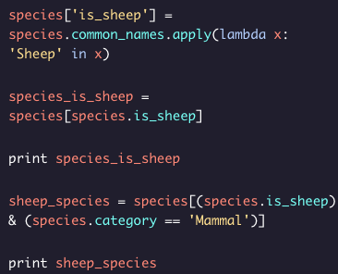
In Search Of Sheep

Slide 10
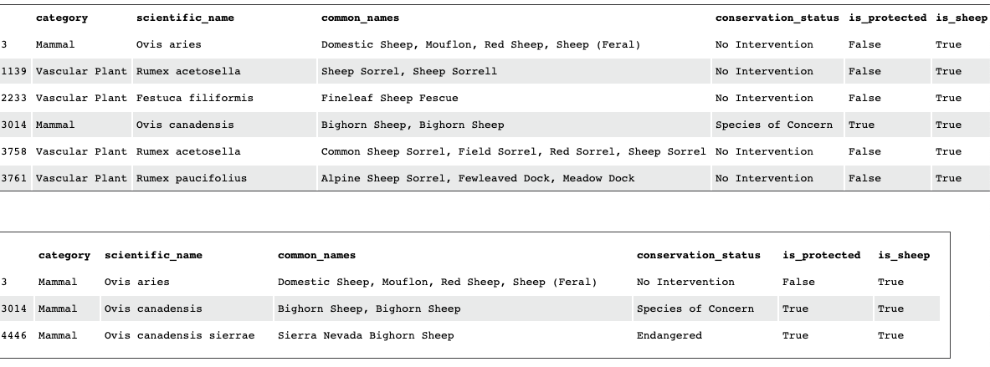
In Search Of Sheep

Slide 11
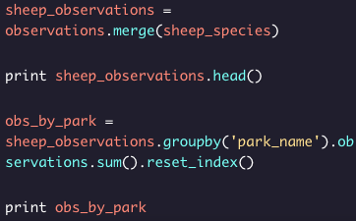
Merging Sheep & Observation

Slide 12
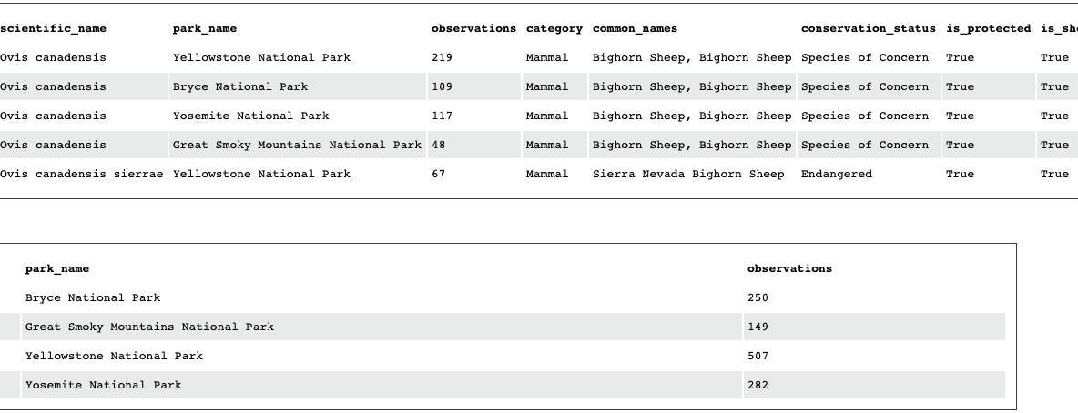
Merging Sheep & Observation

Slide 13
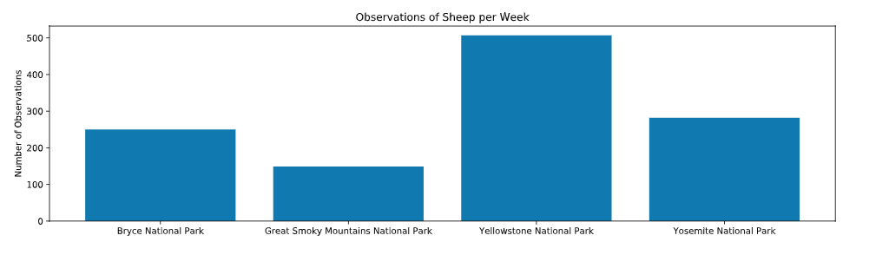
Plotting Sheep Sightings

Slide 14
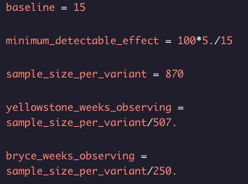
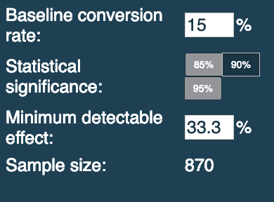
Foot and Mouth Reduction Effort - Sample Size Determination

Slide 15
Foot and Mouth Reduction Effort Notes
In order for scientists to be sure that greater than 5% dropped in cases of foot to mouth diseases they had to observe at least 870 sheep at Yellowstone to be significant due to a 15% baseline occurrence in Bryce National Park.
It would take one week to see that many sheep in Yellowstone but it would take approximately two weeks in Bryce.

